Slide 1

ROBOTIC VISION
1)KS Sreniketh 2)T Jeevan 3)P NITHIN

Slide 2
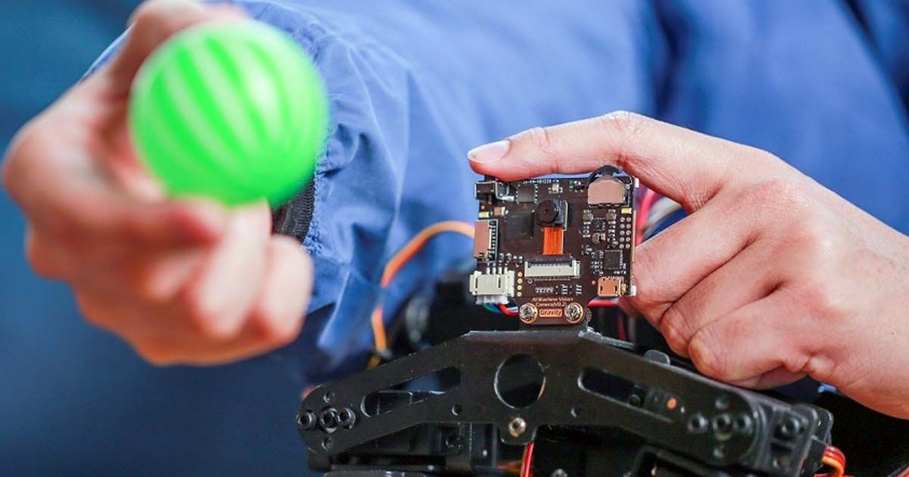
Introduction to ROBOTIC VISION and open cv
Robotic Vision is a combination of camera hardware and computer processed algorithms which helps us in identifying the visual data from the world.
The data can either be 2-Dimensional or 3-Dimensional in nature.
Robotic Vision works on the basis of principles such as Image and Signal processing, Machine Learning and Pattern recognition.
To implement these functions effectively, we use OPEN CV to design a Robotic Vision system.
OPEN CV is a library of programming functions which help us in implementing the above principles.

Slide 3
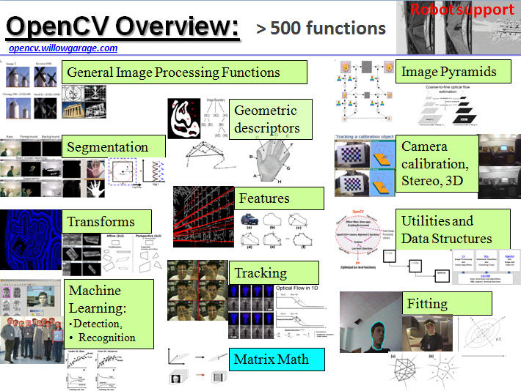
IMPLEMENTATION OF OPEN CV IN ROBOTIC VISION
Open CV (Open Source Computer Vision Library) helps in extracting the information required by using Modules.
In the case of Open CV-Python, we use libraries such as NumPy to perform the same task as that of Open CV.
These modules combine with computing units or processing units to provide the functionalities mentioned(Processing units refer to Arduino, Raspberry Pi)

Slide 4
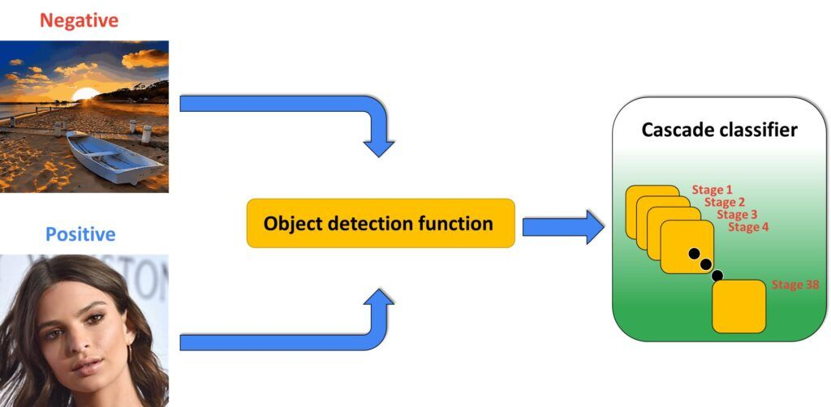
COMPUTATION POWER OF OPEN CV AND ITS ANALYSIS
The code is built around the concept of classifiers to process the inputs of the real-time input data and to perform Object and Person detection and tracking.
Classifiers are defined to be instances of observations grouped into a vector.
The classifier commonly used here is Cascaded/Haar- Cascaded classifier.
Cascaded classifier uses a Machine Learning approach which is trained from a lot of positive and negative images.
Each time, the code is trained by a different classifier as a function to provide proper detection of the output.

Slide 5
COMPUTATION POWER OF OPEN CV AND ITS ANALYSIS
Generally, the output of the person of the object/ person detected is a String output.
However, if we apply the NumPy library, we can also show the co-ordinates of the detected entity.
Linking Arduino to Open CV is made possible by using the concept of Serial communication and UART protocol through which the output is generated and the hardware is controlled successfully.
OPENCV Unit
UART
Serial comms
String/Co-ordinate data
Controller
O/P Load devices
Robotic Vision Controlled Device

Slide 6
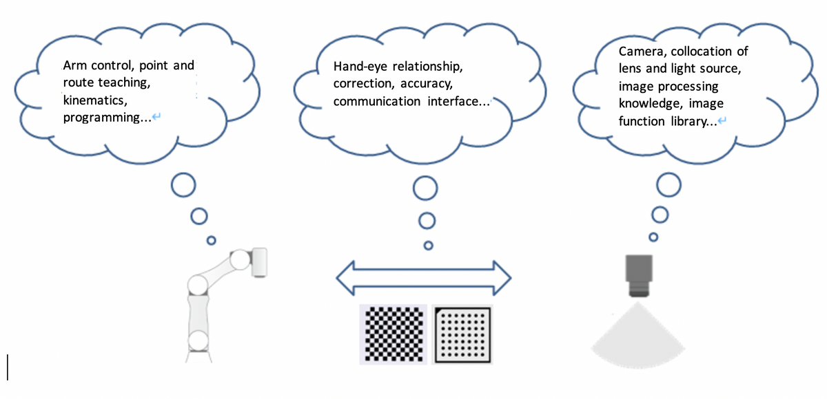
CHALLENGES faced While implementing robotic vision
Some of the key challenges faced while building a Robotic Vision based system are :
Increased circuit complexity.
Bulky nature.
No scope of Code reusability.
In the case of circuit complexity, it becomes quite hard to implement a controller unit using Arduino or Raspberry Pi.
Also, a computing unit like a PC, Laptop is required to control the hardware output which becomes a tiresome process.

Slide 7
SOLUTION
To build a custom OPEN CV processing unit that is User-friendly and supports Cross-Compatibility, whilst eliminating the challenges mentioned in the previous slide.
Usage of an External Camera source of higher resolution to combat issues such as Orientation, Lighting, Occlusion, Efficient Output Capture, etc.,
Writing Dynamic code to make the classifiers intelligently to identify the different instances and perform the required output hardware operation.
Custom OPEN CV Chip
Custom Processing Unit
Operation Mode
Training Mode
Micro-controller Unit
GND, 5V Pins
X,Y,Z co-ordinate Pins
Data o/p Pin

Slide 8
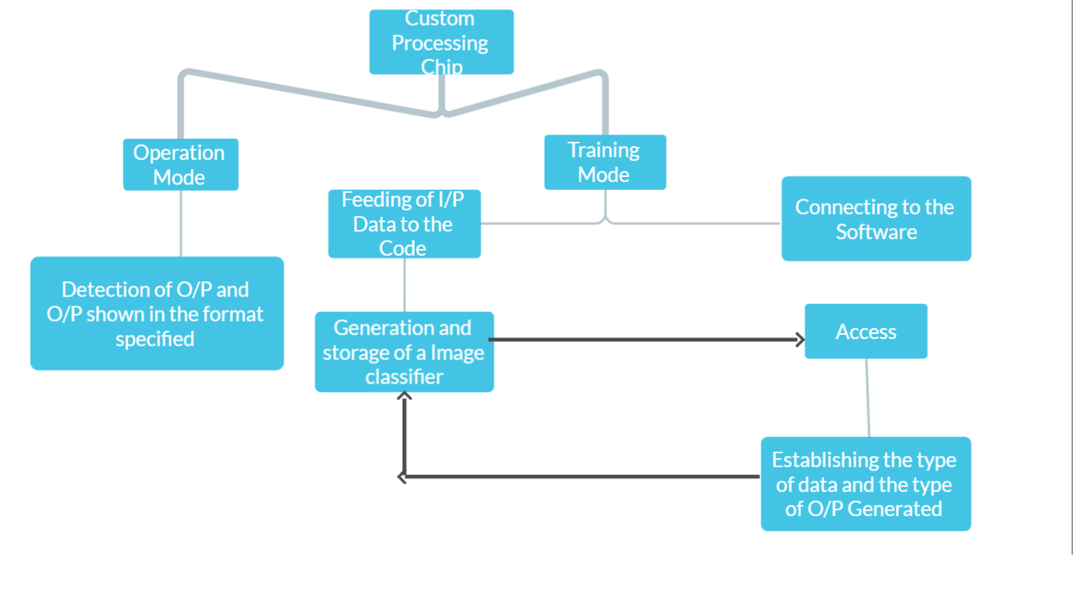
working of custom processing unit

Slide 9

Thank You

